Slide 1
Java on Matlab
Aug 29th, 2018
Yu-Wei Chen
yuweiichen@gmail.com

Slide 2
Outline
Pre-requires
Matlab Environment setting
JavaRobot API Explanation

Slide 3
Pre-requires
Download Eclipse IDE for Java https://www.eclipse.org/downloads/packages/
Clone the project on Github https://github.com/yuweichen1008/JavaRobot
Download the JDK at least version 8_u121 or any version newer http://www.oracle.com/technetwork/java/javase/downloads/jdk8-downloads-2133151.html
(Optional) Install the Matlab (you can find the install on NCTU FTP, but this is optional)

Slide 4
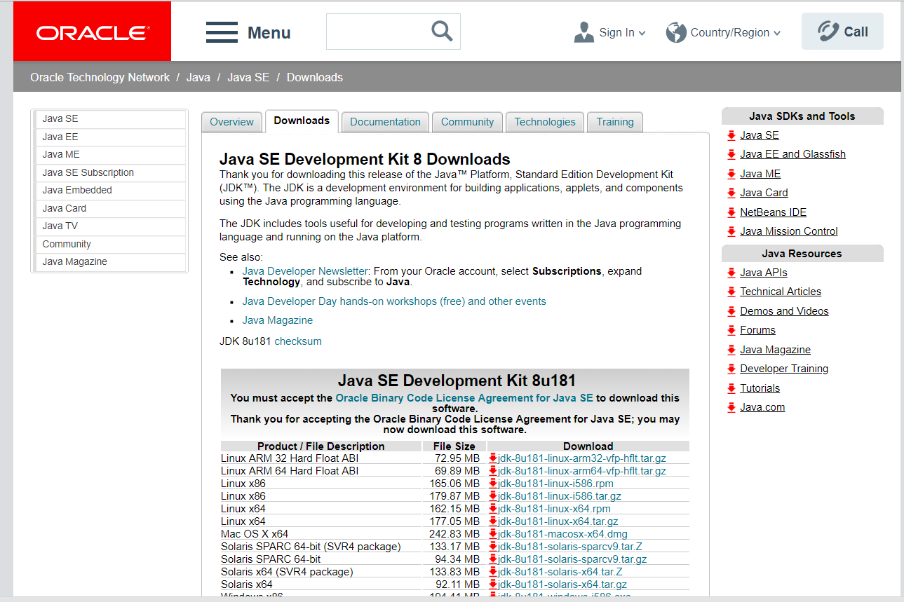
Java JDK download
http://www.oracle.com/technetwork/java/javase/downloads/jdk8-downloads-2133151.html

Slide 5
Matlab Environment Setup
For the Windows 8, 10 environment, JavaRobot used and tested

Slide 6
Matlab Environment setting
In Matlab, Java version is depended on the install environment. To make sure the version of Java is concessive to the version of JavaRobot , type
In the Command Windows
version –java
*Note that if your Java version is not the latest version, please use the uninstall tool here
https://java.com/en/download/uninstalltool.jsp
If the version you are using is not Java Runtime Environment 1.8.0_121 (aka 1.8.0_121-b13), then you may download it from the website or the link here:
http://www.oracle.com/technetwork/java/javase/downloads/jre8-downloads-2133155.html
Current computer is based on x64 structure, make sure you’ve downloaded the right files

Slide 7
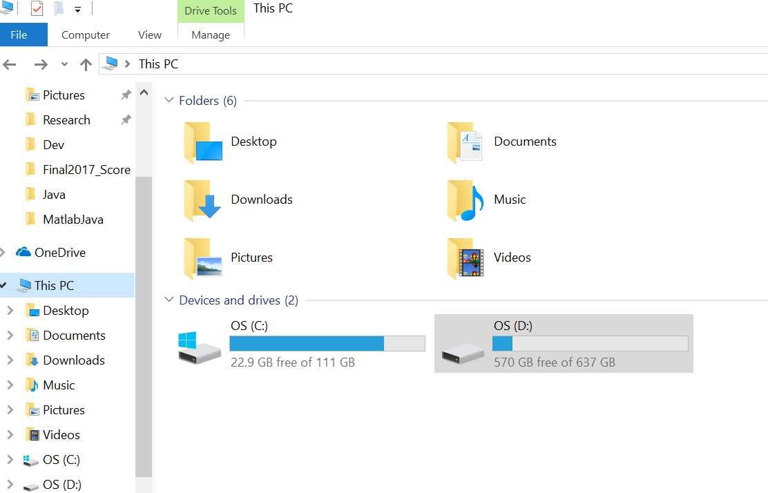
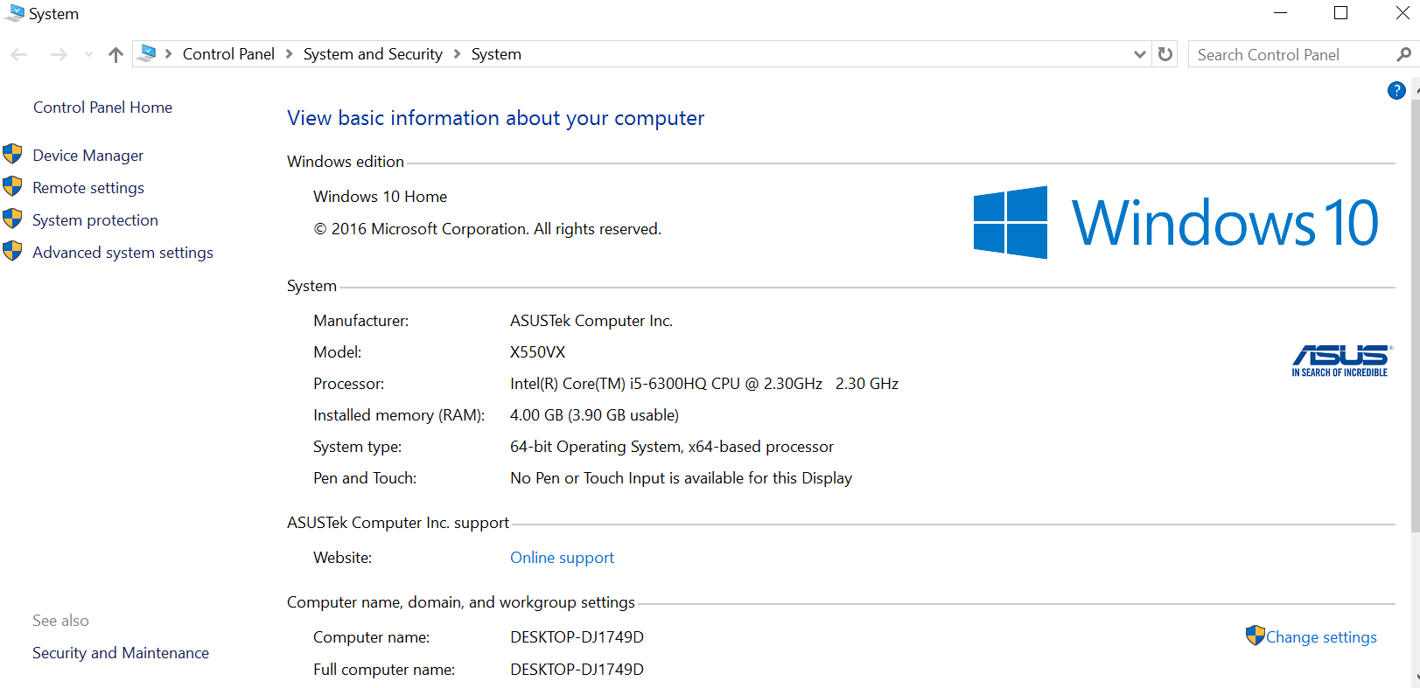
Under Windows Operation System
Step 1 : right click This PC → properties
Step 2 : go to Advanced system settings

Slide 8
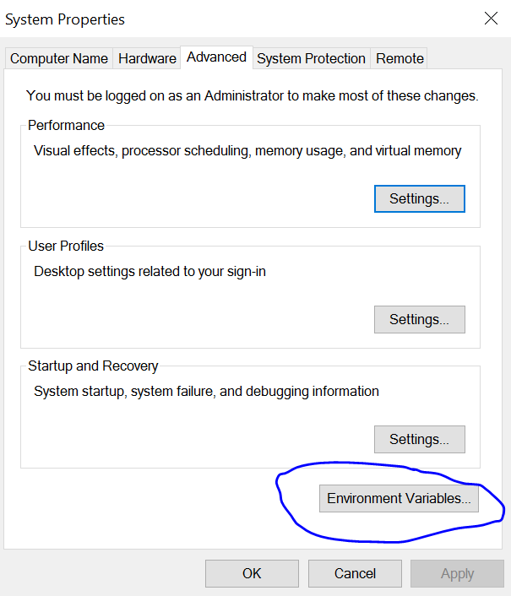
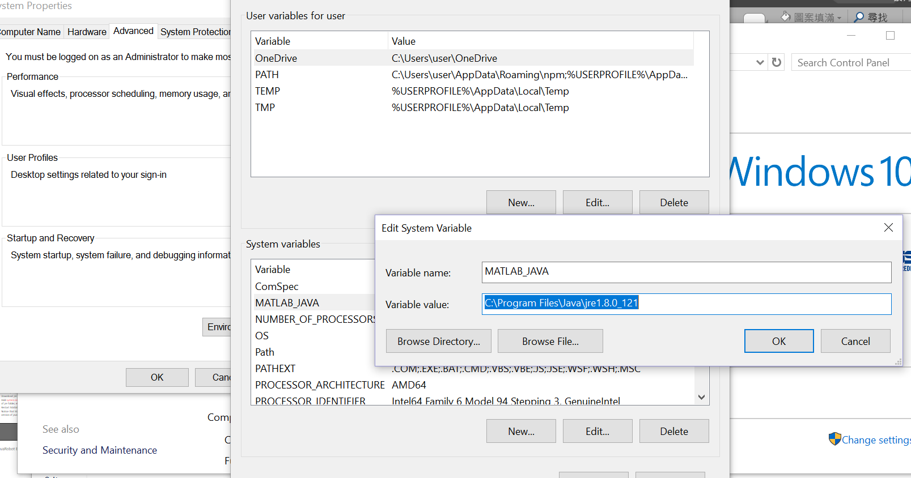
Under Windows OS
Go into the Environment variables
And create a system variable named MATLAB_JAVA with path variable
value of the jre file you’ve install

Slide 9
Matlab Environment setting
If you still got some problem setting up the environment on other OS, the step is quite the same:
Check up Matlab Java version →
Download jre corresponding to the jre file we are using currently →
Add system environment variable called MATLAB_JAVA and its value of jre folder, etc. C:\Program Files\Java\jre 1.8.0_121
Restart Matlab and check version –java again
Notice that Matlab call method may be dysfunctional for other version of java file.

Slide 10
Matlab Static Class addpath
Go to Matlab install folder (C:/ or D:/)
Close the running Matlab
In <Matlab>/tool/local/XXXXX.txt (some config file)
Add the path to jar file with additional newline appends after
Restart Matlab

Slide 11
JavaRobot Explanation
[JavaRobot, Tool, RefPosRMatrix] = JavaRobotRead();
JavaRobot is an object representing the Robot, which be used in every function below.
Tool store the original position data
RefPosRMatrix → Reference Position Rotational Matrix
mThread = JavaRobotMove(Roll, Pitch, Yaw, JavaRobot, Tool, RefPosRMatrix)
mThread means the thread which will make sure the Robot’s moved to the target position
flag = mThread. isRobotMoveFinished()
flag of Boolean 0 -> false(Not yet)/ 1 -> true(Done!)

Slide 12
Ethernet IP configuration for DX200
1) Turn on controller while holding the main menu (主選單) key
2) Go to System -> security and enter 99999999 or 00000000 to go to Maintenance mode
3) Go to Setup -> option function -> select network
4) Setting the network
5) Press Enter (輸入), then the controller is going to ask to modify, it might ask you few time
6) Reboot
7) Done

Slide 13
5 point calibration
We use the 5-point (or more) calibration to set the tool offset from the center TCP.
Procedure: Main Menu -> Robot -> Tool -> Select the tool to create TCP -> Utility -> Calibration

